Slide 1




KEPLER NEXT GEN
Release Management & SNOW Processes
20/01/2022
Kepler

Slide 2
Release Management Key principles
What is Release Management:
Release planning
Release processes
…
All squads working on the Platform follow the same release planning :
Common push to environments
Common NRT period
Common sprints
…
In our release process, we push everything from one environment to another one, all developments of all squads together
Planning of push is defined
Very precise SNOW process to share the same referential and ease all people work.

Slide 3

NEXTGEN - Typical Release Planning
Sprint = 2weeks
Deploy in UAT completed items on Friday
Go- NoGo NRT / Go-NoGo (factory/PL)
Scoping Planning (Dev +PL/PO)
Scope
PL Actions
Freeze UAT
Dev
UT Roll-up
SQUAD
W1
W2
W3
W4
W5
W6
Tests
Business Actions
Priorization
Dev
Testing
Tests
TNR
PTPP
+
PACKAGE VALIDATION
PTP
Dev
Testing
Tests
CRITICAL CORRECTIONs
&ROLLBACK
Dev
Testing

Slide 4
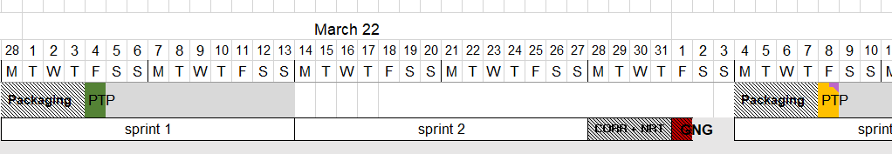
NEXTGEN - Typical Release Planning Example

Slide 5

SNOW: MACRO-PROCESSES
Business Need
Business/PO
PL
PA
Factory
PA/Release team
Squad
Production correction ➔
INCIDENT
➔ Correction required
PRB
ENH
ENH
Quality correction ➔
DEFECT
➔ Correction required
DEFECT
Production evolution ➔
DEMAND
➔ Validation ➔ Validation need➔ Estimation ➔ Validation estimation
ENH
PRODUCT BACKLOG
Select with PL, the scope for the sprint
Communicate to the RM
USER STORY
Prioritization/scope for the release by PO/PL
USER STORY
USER STORY
Send list to RM
Follow the advancement of the sprint
Development
Validation development in INT
Transform Defect/Enh to US.
Review the status of the scope
Test the dev in UAT
PUSH TO UAT
TEST all the sprints and TNR
Validate the dev
GO/No GO
PUSH TO PROD
PUSH TO PRODUCTION

Slide 6
KEPLER Global Agile Process : Demands
From business & tech needs to Sprint Planning
Incoming Topics
Roadmap Creation
Grooming for Scoping
Refinement
(done by the factory)
Sprint Planning
RELEASE
ENHANC. 1
STORY 1
SPRINT 1
STORY 1
DEMAND 1
ENHANC. 2
STORY 2
Roll-out
Evolutions
New Projects
Architecture
Enabler
ENHANC. 3
STORY 3
EPIC
SPRINT 2
DEMAND 2
ENHANC. 4
STORY 4
US 2
US 3
US 6
ENHANC. 2
STORY 5
SPRINT 3
DEMAND 3
US 4
US 6
ENHANC. 3
STORY 6

Slide 7
First deployment
GO/NOGO NRT
GO/NOGO
RELEASE
PTP
FREEZE ENVIRONEMENT
DEVELOPEMENT
DOR/DOD
OnlyUS that have been groomed and are now respected the DOR can be added to the sprint backlog
SPRINT
Sprint = 2 weeks
Developers are working on what has been defined during the sprint planning
Developers are doing pull requests in order to deploy their dev through all environement
At every steps of the dev journey they are criterias to respect, and at the end of the sprint only US that are respected the DOD can be tested by the business
Correction UAT
Correction NRT
Developers are working only on Defects and not finished developments in order to secure the UAT environement
Developers are working only to correct NRT critical defects
DEPLOYMENT
Deployment in DEV
Deployment all day long
Deployment in INT
Everyday
Deployment in UAT
Twice a week
Must respect ready to push to INT criterias
Must respect ready to push to UAT criterias
Continuous deployment
Only new version of an existing US or defects correction can be deployed
All other developments are not merged until PTP
TESTS
Developer
In the first merged environment Developer are doing the first Unit test
Quality Assurance
In the INT environment QA are doing functional tests according to acceptance criteria
Business
In UAT Business are putting their last validation of the development
Final tests
NRT
All US to retest (TBC)

Slide 8
Deployment process & SNOW statuses
RELEASE
SPRINT
Draft – not started
Ready – not started
Ready – In Progress
Ready for testing – not started
Testing – Not started
Testing – In progress
Testing – Done
Complete
TESTED KO : back in Dev for a PRIORITIZED correction
Work in progress – not started
Dev
If ALL US are tested in DEV
GO/
NOGO
Dev
DEVELOP
INT
UAT
PROD
Dev
Dev
DEV TESTS
BA TESTS
BUS TESTS
All day long
Once a day before 5 PM
Twice a sprint
(Wednesday & Monday morning)
Once a release
All deployment are full merge, no cherry picking, the gate is between DEVELOP and INT environment : only IF ALL US are OK the merge will happen
Snow status :
Just pushed : To test in the environment
Just validated : To push to the new environment
All items KO must be at “Work in progress – not started”
To test
To push
KO

Slide 9

Push to Environment: criterias
Phase | Which criteria to be reviewed by Release Managers ?
Before pushing to INT | User story is created User story scoped to the release & sprint Evidence of testing attached Status “ready for testing – not started”
Before pushing to UAT | User story is created User story scoped to the release & sprint Evidence of testing attached Status “testing – in progress”
Before Push to Prod | All items in UAT are tested OK NRT scoped is validated by business NRT are OK NRT steps are updated for next push to prod Release note is completed List of testers and release managers is known Cut-over validated

Slide 10
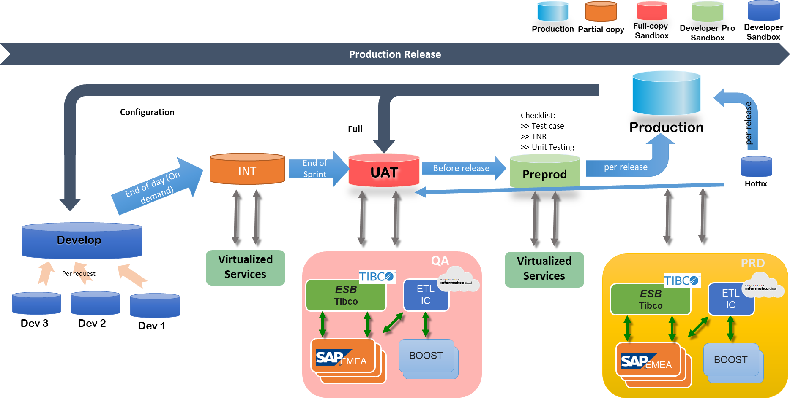
KEPLER Landscape
2x / sprint
Every day
New: DevOps adapted
Preprod for Staging.

Slide 11
HOTFIX PROCESS
Any action in Production that needs to be done outside the Push to Production date, and which is not managed through Service Request.

Slide 12
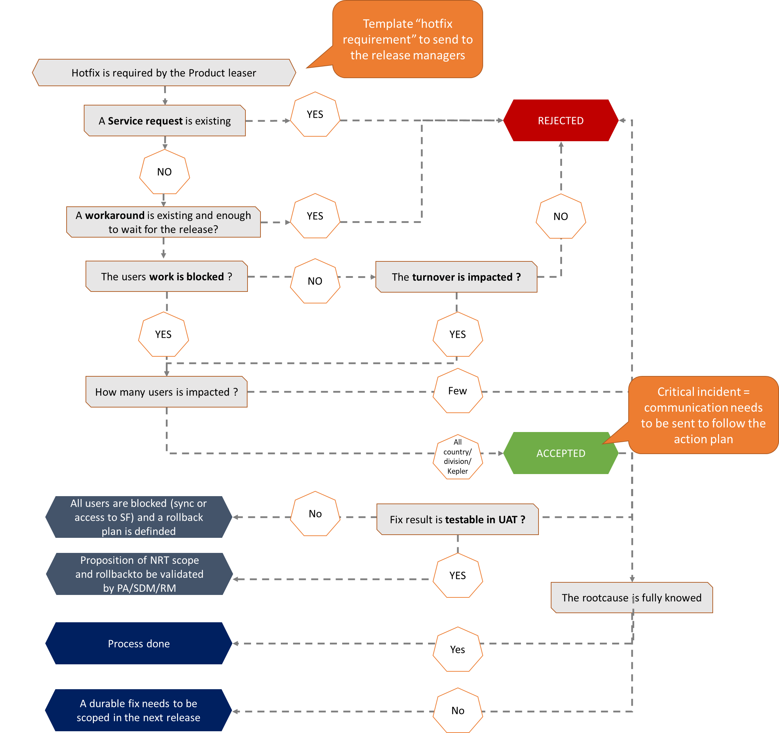
HOTFIX PROCESS

Slide 13
Hotfix template requirement
Product | ID Snow | Number of users impacted (few/randomly/all) | Impact on Business | Workaround ? | Appears since when ? (INC Creation date) | Rootcause ? | What is the fix ? Manual steps / Deployment / New app | Impact on others products ? | Proposition of NRT Scope | Advancement of the dev % | Questions/comments from release manager ? | Release manager Validation

Slide 14
HOTFIX Acceptance criterias
Phase | Which AC to be reviewed by Release Managers ?
Before Hotfix | User story is created Hotfix requirement template filled Hotfix validated by Release manager & PA NRT done Business validated the fix in UAT

Slide 15
CONCLUSION
The aim of Release management is to secure the Production, by controlling what is pushed in production and how. This is crucial.
All processes described must be strictly followed. Even if they seems heavy, they are defined to:
Ensure a common way of working and then understanding
Help all teams to work more efficiently
We count on you !

Slide 16
ANNEXES

Slide 17
Demand |  | Incident |  | Problem |  | Enhancement |  | User story |  | Meaning | To be done by
Status | substatus | Status | substatus | Status | substatus | Status | substatus | Status | substatus
New |  |  |  |  |  |  |  |  |  | Evolution needed : creation | Business/PL
Assessment | Not started |  |  |  |  |  |  |  |  |  | PA
Assessment | Done |  |  |  |  |  |  |  |  | Estimation provided | DEV
Comitte review |  |  |  |  |  |  |  |  |  |  | PA
Approved |  |  |  |  |  | New (automatically creation) |  | Draft (manual creation) |  | Scoped for development | PL
Approved |  |  |  |  |  | New |  | Ready | Not started | Ready to be pushed in Develop | DEV
Approved |  |  |  |  |  | New |  | Ready | In progress | Deployed in Develop to be tested by Dev | Release Manager
Approved |  |  |  |  |  | Build (automatically) | done | Ready for testing | Not started | TESTED OK IN DEVELOP & Ready to be pushed in INT | DEV
Approved |  |  |  |  |  | Testing (automatically) | done | Testing | Not started | Deployed in INT to be tested by BA | Release Manager
Approved |  |  |  |  |  | Testing (automatically) |  | Testing | In progress | TESTED OK IN INT & Ready to be pushed in UAT, if KO push test failed | BA
Approved |  |  |  |  |  | Testing (automatically) |  | Testing | done | Deployed in UAT, to be tested by LVL 1 | Release Manager
Approved |  |  |  |  |  | To be deployed |  | Complete |  | TESTED OK IN UAT & Ready to be pushed in Preprod | Business
Approved |  |  |  |  |  | WIP |  | WIP |  | TESTED KO | Business/BA
 |  | New |  |  |  |  |  |  |  | Issue Escalation to LVL2 | Business/LVL1
 |  | Active |  |  |  |  |  |  |  | First analysis | DEV
 |  | Awaiting change |  | New (manual creation) |  | New (automatically creation) |  | Draft (manual creation) |  | Scoped for development | PL
 |  | Awaiting change |  | New |  | New |  | Ready | Not started | Ready to be pushed in Develop | DEV
 |  | Awaiting change |  | New |  | New |  | Ready | In progress | Deployed in Develop to be tested by Dev | Release Manager
 |  | Awaiting change |  | New |  | Build (automatically) | done | Ready for testing | Not started | TESTED OK IN DEVELOP & Ready to be pushed in INT | DEV
 |  | Awaiting change |  | Work in progress (automatically) |  | Testing (automatically) | done | Testing | Not started | Deployed in INT to be tested by BA | Release Manager
 |  | Awaiting change |  | Work in progress |  | Testing (automatically) |  | Testing | In progress | TESTED OK IN INT & Ready to be pushed in UAT, if KO push test failed | BA
 |  | Awaiting change |  | Work in progress |  | Testing (automatically) |  | Testing | done | Deployed in UAT, to be tested by LVL 1 | Release Manager
 |  | Awaiting change |  | Resolved (manual) |  | To be deployed |  | Complete |  | TESTED OK IN UAT & Ready to be pushed in Preprod | Business
 |  | Awaiting change |  | Work in progress (automatically) |  | WIP |  | WIP |  | TESTED KO | Business/BA
Closed |  | Resolved |  | Closed |  | Closed |  | Complete |  | Correction/evolution in production | SDM

